Slide 1
Final conference
Amsterdam
21,22 and 23rd March 2018

Slide 2
Ideas
Student stories activities
Presentations
Schools -
Hospitality
Transport
What can we do for you?

Slide 3
Ideas
Stage show
Student stories / activities / Rusults from the lessons and final assignments (module 3)
Best practice
Employers involved, they will be by us regardless, we can involve them

Slide 4
Student activities
All first year students will have followed all 12 lessons from our project, they can present, partake etc.
Inviting teachers from other schools (Paloma’s idea)

Slide 5
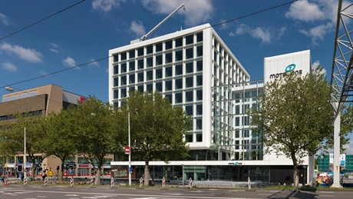
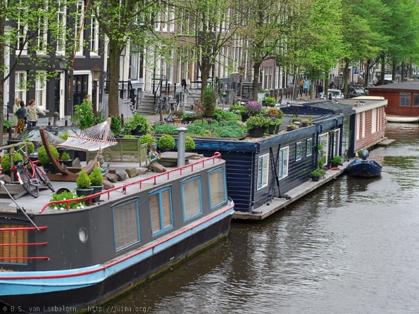
Hospitality
Amsterdam = expensive
Hotel One – Single € 81,75 / Twin € 106,96
Incl breakfast
Houseboat about double if we book now. But March is not extremely busy, better rates can be had closer to the date

Slide 6
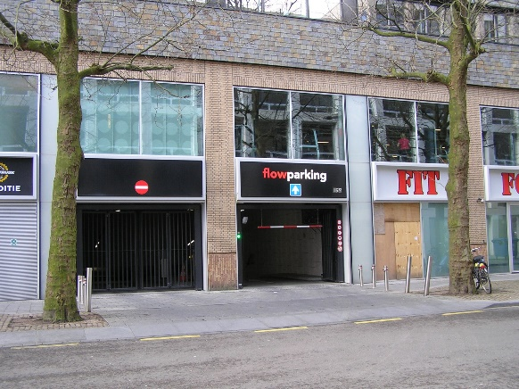
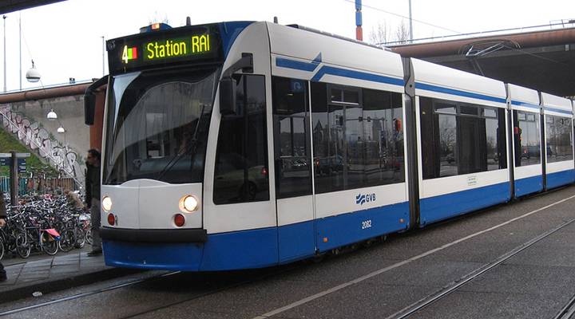
Transport
Parking is expensive, € 5 per car per hour. Garage under the school
Public transport, We can send you detailed info, but need to know what you need. There are many kind of tickets available.

Slide 7
Final conference
Amsterdam
21,22 and 23rd March 2018
What can we do for you?
p.vanderbent@rocva.nl
+31-6-42314853

